Slide 1

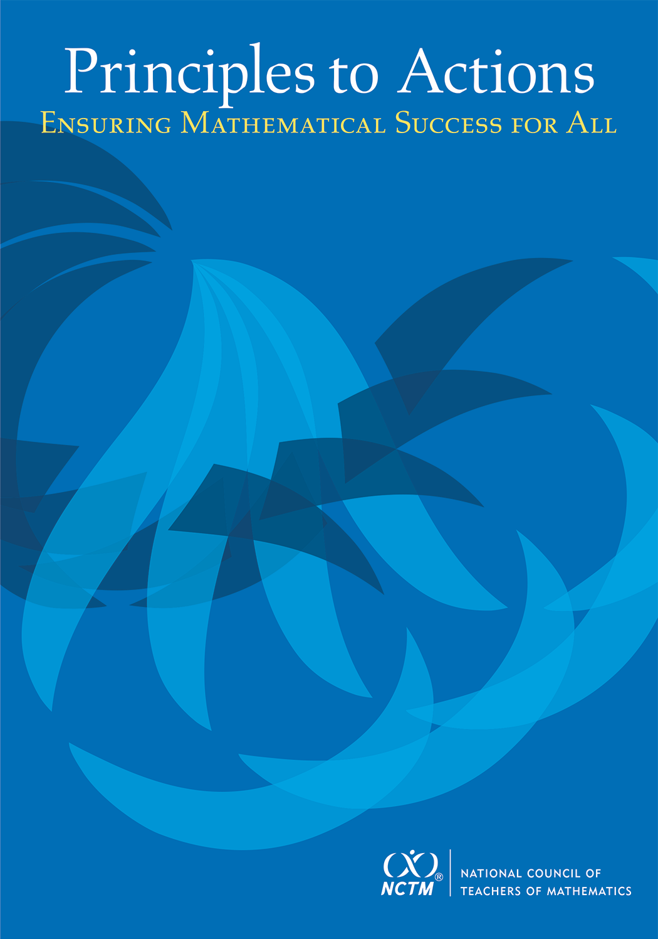
Collaborate, Communicate, Connect:
High-Leverage Practices to Turn
Standards into Learning
Please take a handout as you enter.
Diane J. Briars
Past President
National Council of Teachers of Mathematics dbriars@nctm.org
Alabama Council of Teachers of Mathematics
November 3, 2016

Slide 2
FYI
Electronic copies of slides will be posted at nctm.org/briars
or are available by request
dbriars@nctm.org

Slide 3
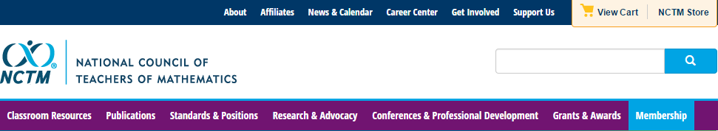
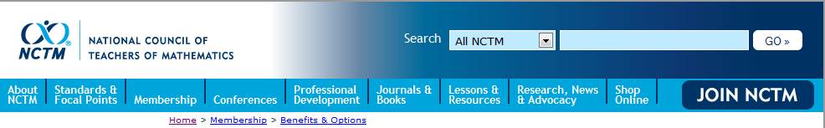
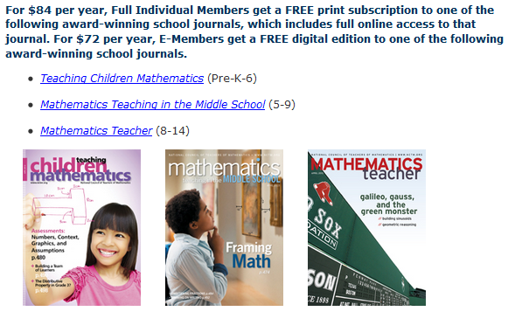
National Council of Teachers of Mathematics www.nctm.org

Slide 4



National Council of Teachers of Mathematics www.nctm.org
National Council of Teachers of Mathematics
www.nctm.org
For $144 per year, your school will get a FREE print-only subscription to one of the following award-winning journals:
Five FREE E-Memberships for teachers in your school
All the benefits of an e-membership including full access to
the digital edition of Teaching Children Mathematics or
Mathematics Teaching in the Middle School (a $72 value!) FREE!
To involve more teachers, additional e-memberships can be added
for just $10 each.

Slide 5
National Council of Teachers of Mathematics www.nctm.org
National Council of Teachers of Mathematics
www.nctm.org
New Member Discount
$20 off for full membership
$10 off e-membership
$5 off student membership
Use Code: BDB0616

Slide 6


Community. Collaboration. Solutions.
Bring your team and engage in a hands-on, interactive, and new
learning experience for mathematics education.
With a focus on “Engaging the
Struggling Learner,” become part
of a team environment and navigate
your experience through three
different pathways:
Response to Intervention (RtI)
Supporting productive struggle
Motivating the struggling learner

Slide 7
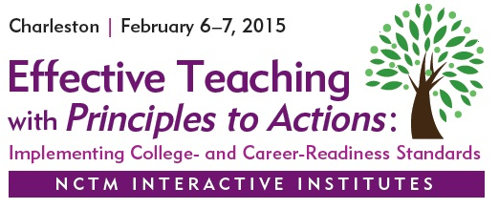
NCTM Interactive Institute www.nctm.org
Grades PK-5, 6-8, High School, and School Leaders
February 3–4, 2017
San Diego

Slide 8

2017 NCTM Annual Meeting and Exposition www.nctm.org
  April 5–8, 2017
  San Antonio

Slide 9
Agenda
Identify effective teaching practices that promote students’ proficiency in rigorous mathematics standards, e.g., CCSS-M/AL COS
Read and analyze a short case of a teacher (Mr. Donnelly) who is attempting to support his students’ learning
Discuss selected effective teaching practices and relate them to the case
Identify high-leverage actions—those that will produce the greatest impact for your effort—in enacting the effective teaching practices in your classroom, school, and district.

Slide 10

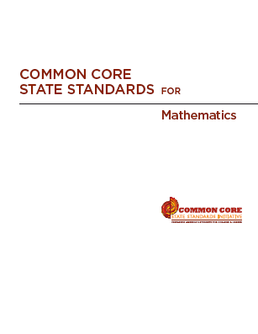
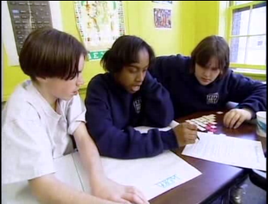
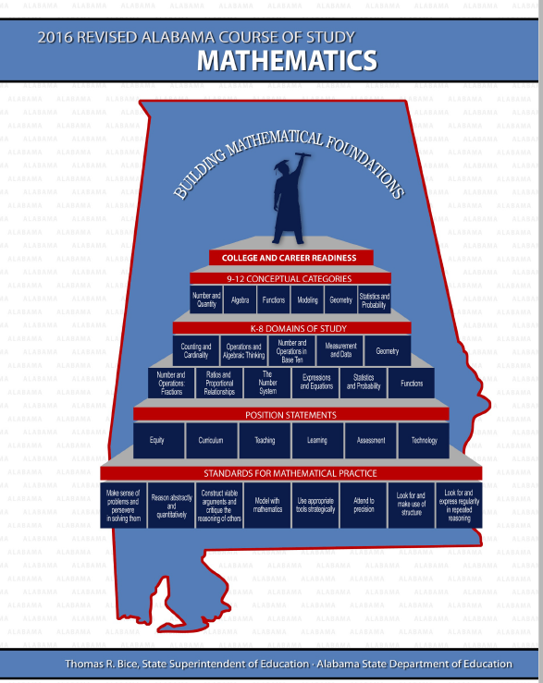
High Quality Standards Are Necessary, but Insufficient, for Effective Teaching and Learning

Slide 11
Principles to Actions:
Ensuring Mathematical Success for All
  Describes the supportive conditions, structures, and policies required to give all students the power of mathematics
  Focuses on teaching and
  learning
  Emphasizes engaging students
  in mathematical thinking
  Describes how to ensure that
  mathematics achievement is maximized for every student
  Is not specific to any standards; it’s universal

Slide 12
Key Features of CCSS-M
Focus: Focus strongly where the standards focus.
Coherence: Think across grades, and link to major topics
Rigor: In major topics, pursue conceptual understanding, procedural skill and fluency, and application
Standards for Mathematical Practice

Slide 13
Key Features of CCSS-M
Focus: Focus strongly where the standards focus.
Coherence: Think across grades, and link to major topics
Rigor: In major topics, pursue conceptual understanding, procedural skill and fluency, and application
Standards for Mathematical Practice

Slide 14
Curriculum Standards,
Not Assessment Standards
Understand and apply properties of operations and the relationship between addition and subtraction. (1.OA)
3. Apply properties of operations as strategies to add and subtract. Examples: If 8 + 3 = 11 is known, then 3 + 8 = 11 is also known. (Commutative property of addition.) To add 2 + 6 + 4, the second two numbers can be added to make a ten, so 2 + 6 + 4 = 2 + 10 = 12. (Associative property of addition.)
4. Understand subtraction as an unknown-addend problem. For example, subtract 10 – 8 by finding the number that makes 10 when added to 8.

Slide 15
Curriculum Standards,
Not Assessment Standards
Define, evaluate, and compare functions. (8.F)
1. Understand that a function is a rule that assigns to each input exactly one output. The graph of a function is the set of ordered pairs consisting of an input and the corresponding output.

Slide 16
Why Focus on Understanding??
Understanding facilitates initial learning and retention.
Understanding supports appropriate application and transfer.

Slide 17
Key Features of CCSS-M
Focus: Focus strongly where the standards focus.
Coherence: Think across grades, and link to major topics
Rigor: In major topics, pursue conceptual understanding, procedural skill and fluency, and application
Standards for Mathematical Practice

Slide 18
Key Features of CCSS-M
Focus: Focus strongly where the standards focus.
Coherence: Think across grades, and link to major topics
Rigor: In major topics, pursue conceptual understanding, procedural skill and fluency, and application
Standards for Mathematical Practice

Slide 19
Standards for Mathematical Practice
  Make sense of problems and persevere in solving them.
  Reason abstractly and quantitatively.
  Construct viable arguments and critique the reasoning of others.
  Model with mathematics.
  Use appropriate tools strategically.
  Attend to precision.
  Look for and make use of structure.
  Look for and express regularity in repeated reasoning.

Slide 20
Phil Daro, 2010
Notes:
20

Slide 21
Phil Daro, 2010
Notes:
21

Slide 22
Other “Butterflies”?
FOIL
Cross multiplication
Fraction division:
  Keep-change-flip, KFC,
  Yours is not to reason why, just invert and multiply
Integer subtraction: Keep-change-change (a - b = a + ⁻ b)
Long Division:
  Dad, Mother, Sister, Brother, Rover
  Does McDonalds Sell Cheese Burgers?
Key words

Slide 23
Key Instructional Shift
From emphasis on:
How to get answers
To emphasis on:
Understanding mathematics

Slide 24
Implementing CCSS-M Requires
Instructional practices that promote students’ development of conceptual understanding and proficiency in the Standards for Mathematical Practice.

Slide 25
Guiding Principles
for School Mathematics
Teaching and Learning
Effective teaching is the non-negotiable core that ensures that all students learn mathematics at high levels.

Slide 26
We Must Focus on Instruction
Student learning of mathematics “depends fundamentally on what happens inside the classroom as teachers and learners interact over the curriculum.”
(Ball & Forzani, 2011, p. 17)
“Teaching has 6 to 10 times as much impact on achievement as all other factors combined ... Just three years of effective teaching accounts on average for an improvement of 35 to 50 percentile points.”
Schmoker (2006, p.9)

Slide 27
Guiding Principles
for School Mathematics
Teaching and Learning
Access and Equity
Curriculum
Tools and Technology
Assessment
Professionalism
Essential Elements
of Effective Math
Programs

Slide 28
Candy Jar Problem
A candy jar contains 5 Jolly Ranchers (squares) and 13 Jawbreakers (circles). Suppose you had a new candy jar with the same ratio of Jolly Ranchers to Jawbreakers, but it contained 100 Jolly Ranchers. How many Jawbreakers would you have? Explain how you know.
Please work this problem as if you were a seventh grader.
When done, share your work with a neighbor.
Discuss:
What mathematics learning could this task support?

Slide 29
Candy Jar Task
Common Core State Standards 7.RP:
2. Recognize and represent proportional relationships between quantities.
Decide whether two quantities are in a proportional relationship, e.g., by testing for equivalent ratios in a table or graphing on a coordinate plane and observing whether the graph is a straight line through the origin.
Identify the constant of proportionality (unit rate) in tables, graphs, equations, diagrams, and verbal descriptions of proportional relationships.
Represent proportional relationships by equations. For example, if total cost t is proportional to the number n of items purchased at a constant price p, the relationship between the total cost and the number of items can be expressed as t = pn.
Explain what a point (x, y) on the graph of a proportional relationship means in terms of the situation, with special attention to the points (0, 0) and (1, r) where r is the unit rate.

Slide 30
Standards for Mathematical Practice
  Make sense of problems and persevere in solving them.
  Reason abstractly and quantitatively.
  Construct viable arguments and critique the reasoning of others.
  Model with mathematics.
  Use appropriate tools strategically.
  Attend to precision.
  Look for and make use of structure.
  Look for and express regularity in repeated reasoning.

Slide 31
The Case of Mr. Donnelly
Read the Case of Mr. Donnelly and study the strategies used by his students.
Make note of what Mr. Donnelly did before or during instruction to support his students’ learning and understanding of proportional relationships.
Talk with a shoulder-partner about the actions and interactions that you identified as supporting student learning.

Slide 32
Principle on Teaching and Learning
An excellent mathematics program requires effective teaching that engages students in meaningful learning through individual and collaborative experiences that promote their ability to make sense of mathematical ideas and reason mathematically.

Slide 33
Effective
Mathematics Teaching Practices
Establish mathematics goals to focus learning.
Implement tasks that promote reasoning and problem solving.
Use and connect mathematical representations.
Facilitate meaningful mathematical discourse.
Pose purposeful questions.
Build procedural fluency from conceptual understanding.
Support productive struggle in learning mathematics.
Elicit and use evidence of student thinking.

Slide 34
Effective
Mathematics Teaching Practices
Establish mathematics goals to focus learning.
Implement tasks that promote reasoning and problem solving.
Use and connect mathematical representations.
Facilitate meaningful mathematical discourse.
Pose purposeful questions.
Build procedural fluency from conceptual understanding.
Support productive struggle in learning mathematics.
Elicit and use evidence of student thinking.

Slide 35
Establish Mathematics Goals
To Focus Learning
Learning Goals should:
Clearly state what it is students are to learn and understand about mathematics as the result of instruction;
Be situated within learning progressions; and
Frame the decisions that teachers make during a lesson.
Formulating clear, explicit learning goals sets the stage for everything else.
(Hiebert, Morris, Berk, & Janssen, 2007, p.57)

Slide 36
Candy Jar Task
Common Core State Standards 7.RP:
2. Recognize and represent proportional relationships between quantities.
Decide whether two quantities are in a proportional relationship, e.g., by testing for equivalent ratios in a table or graphing on a coordinate plane and observing whether the graph is a straight line through the origin.
Identify the constant of proportionality (unit rate) in tables, graphs, equations, diagrams, and verbal descriptions of proportional relationships.
Represent proportional relationships by equations. For example, if total cost t is proportional to the number n of items purchased at a constant price p, the relationship between the total cost and the number of items can be expressed as t = pn.
Explain what a point (x, y) on the graph of a proportional relationship means in terms of the situation, with special attention to the points (0, 0) and (1, r) where r is the unit rate.

Slide 37
Goals to Focus Learning
Mr. Donnelly’s goal for students’ learning:
Students will recognize that quantities that are in a proportional (multiplicative) relationship grow at a constant rate and that there are three key strategies that could be used to solve problems of this type – scaling up, scale factor, and unit rate.
How does his goal align with this next teaching practice?

Slide 38
Implement Tasks that Promote
Reasoning and Problem Solving
Mathematical tasks should:
Provide opportunities for students to engage in exploration or encourage students to use procedures in ways that are connected to concepts and understanding;
Build on students’ current understanding; and
Have multiple entry points.

Slide 39
Why Tasks Matter
Tasks form the basis for students’ opportunities to learn what mathematics is and how one does it;
Tasks influence learners by directing their attention to particular aspects of content and by specifying ways to process information;
The level and kind of thinking required by mathematical instructional tasks influences what students learn; and
Differences in the level and kind of thinking of tasks used by different teachers, schools, and districts, is a major source of inequity in students’ opportunities to learn mathematics.

Slide 40
Why Tasks Matter
Tasks form the basis for students’ opportunities to learn what mathematics is and how one does it;
Tasks influence learners by directing their attention to particular aspects of content and by specifying ways to process information;
The level and kind of thinking required by mathematical instructional tasks influences what students learn; and
Differences in the level and kind of thinking of tasks used by different teachers, schools, and districts, is a major source of inequity in students’ opportunities to learn mathematics.

Slide 41






Comparing Tasks
Finding the Missing Value
Find the value of the unknown in each of the proportions shown below.
How is Mr. Donnelly’s task (Candy Jar) similar to or different from the Missing Value problem?
Which one is more likely to promote problem solving?
Notes:
2 minutes to turn and talk
Same
Content
Both could be solved using cross multiplication
Different
Multiple ways to enter Candy Jar – picture, build model, make table
Multiple ways to solve CJ – scale factor, scaling up, unit rate
No implied way of solving CJ
Where the task could be used – beginning of a unit vs practicing a procedure
CJ has the potential to promote problem solving. The context also helps students in making sense of what the numbers they come up with actually mean.

Slide 42
Core Instructional Issue
Do all students have the opportunity to engage in mathematical tasks that promote students’ attainment of the mathematical practices on a regular basis?

Slide 43
Facilitate
Meaningful Mathematical Discourse
Mathematical Discourse should:
Build on and honor students’ thinking;
Provide students with the opportunity to share ideas, clarify understandings, and develop convincing arguments; and
Advance the mathematical learning of the whole class.

Slide 44
Facilitate
Meaningful Mathematical Discourse
Discussions that focus on cognitively challenging mathematical tasks, namely those that promote thinking, reasoning, and problem solving, are a primary mechanism for promoting conceptual understanding of mathematics (Hatano & Inagaki, 1991; Michaels, O’Connor, & Resnick, 2008).
Smith, Hughes, Engle & Stein, 2009, p. 549

Slide 45
Meaningful Discourse
What did Mr. Donnelly do (before or during the discussion) that may have positioned him to engage his students in a productive discussion?

Slide 46
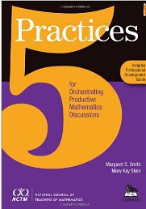
Five Practices for Orchestrating Productive Mathematics Discussions
Anticipating likely student responses
Monitoring students’ actual responses
Selecting particular students to present their work during the whole class discussion
Sequencing the students’ presentations
Connecting different students’ strategies and ideas in a way that helps students understand the mathematics or science in the lesson.
Smith & Stein, 2011;

Slide 47
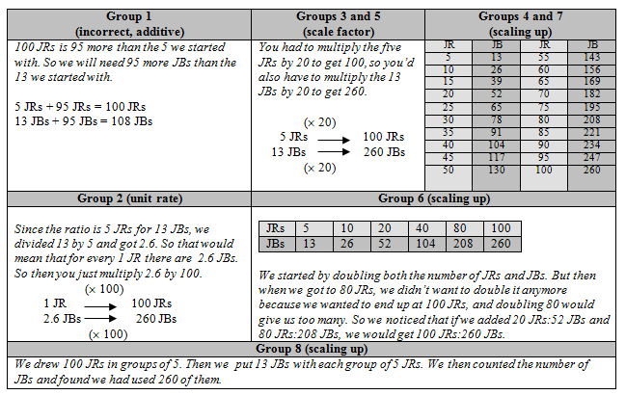
How did Mr. Donnelly use the 5 practices to structure the summary discussion?

Slide 48
Planning with the Student in Mind
Anticipate solutions, thoughts, and responses that students might develop as they struggle with the problem/task.
Generate questions that could be asked to promote student thinking during the lesson, and consider the kinds of guidance that could be given to students who showed one or another types of misconception in their thinking
Determine how to end the lesson so as to advance students’ understanding
  Stigler & Hiebert, 1997

Slide 49
Planning with the Student in Mind
Strategy/ Response | Questions | Students/ Group | Order
Unit Rate: Picture
Unit Rate: Table
Scale Factor:
Scaling Up: Table
Scaling Up: Picture
Additive

Slide 50
Elicit and Use Evidence
of Student Thinking
Evidence should:
Provide a window into students’ thinking;
Help the teacher determine the extent to which students are reaching the math learning goals; and
Be used to make instructional decisions during the lesson and to prepare for subsequent lessons.

Slide 51
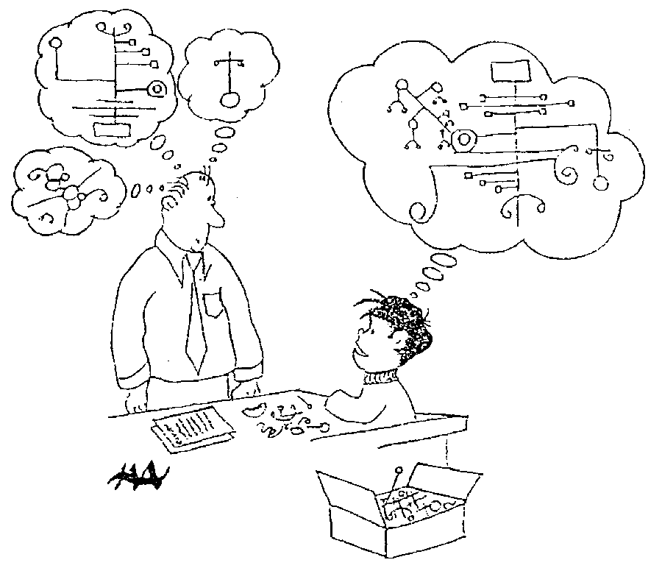
Harold Asturias, 1996
Notes:
This cartoon illustrates what assessment is really about.
Each student develops some concept of mathematics is. Our jobs as teachers and administrators is to figure out what is going on in our students heads.
What do they really understand about mathematics? Unfortunately we can’t just open up the kid’s head and look.
We are restricted to look at visible and tangible evidence---what they say and do. In classrooms, we have a wide variety of evidence available for us.
At the district level, we are often stuck with what kids actually do, often on on-demand types of test.
A critical question is how good are our inferences? To what extent are we actually developing a accurate perception of what kids actually know?
This is what we are call valid inferences. We are making inferences of what children know when our idea of what they know matches, as well as possible, to what they actually understand. We never want to assume that they know something that they don’t, and we also don’t want to assume that they don’t know something that they do.

Slide 52
Formative assessment is an essentially interactive process, in which the teacher can find out whether what has been taught has been learned, and if not, to do something about it. Day-to-day formative assessment is one of the most powerful ways of improving learning in the mathematics classroom.
Wiliam, 2007, pp. 1054; 1091

Slide 53
Effective
Mathematics Teaching Practices
Establish mathematics goals to focus learning.
Implement tasks that promote reasoning and problem solving.
Use and connect mathematical representations.
Facilitate meaningful mathematical discourse.
Pose purposeful questions.
Build procedural fluency from conceptual understanding.
Support productive struggle in learning mathematics.
Elicit and use evidence of student thinking.

Slide 54
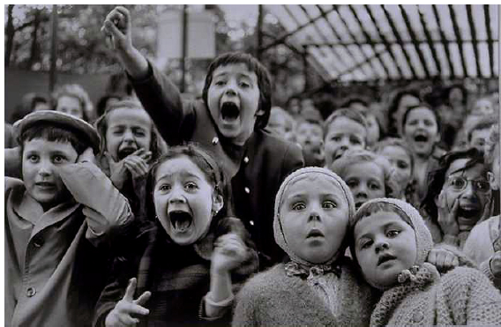
Your Feelings Looking Ahead?

Slide 55
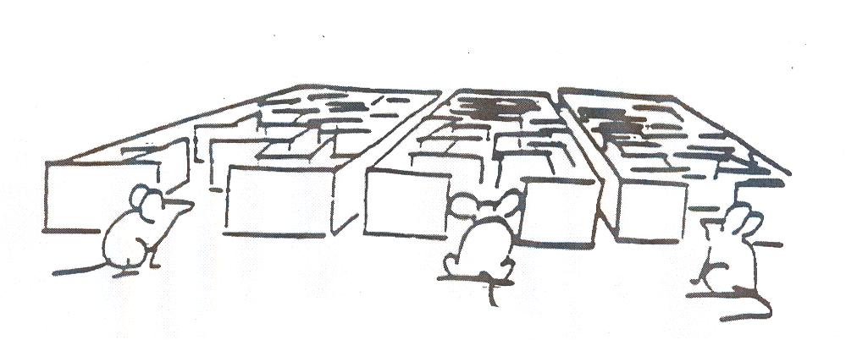
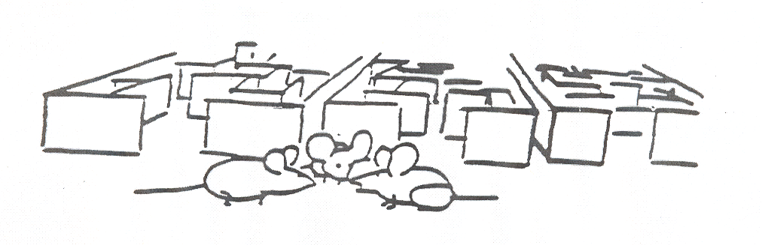
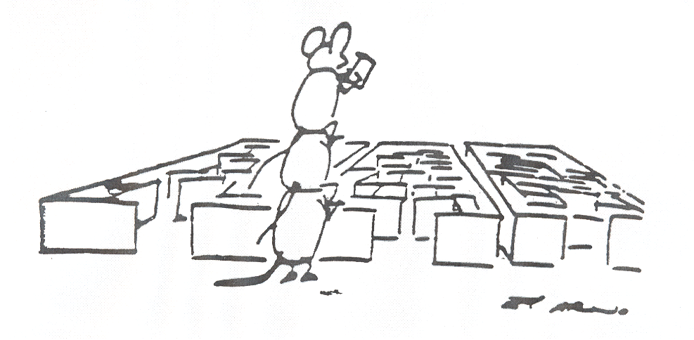

Slide 56
Principles to Actions:
Ensuring Mathematical Success for All
Teaching and Learning
Access and Equity
Curriculum
Tools and Technology
Assessment
Professionalism
Essential Elements
of Effective Math
Programs

Slide 57
Guiding Principles for School Mathematics
Professionalism
In an excellent mathematics program, educators hold themselves and their colleagues accountable for the mathematical success of every student and for their personal and collective professional growth toward effective teaching and learning of mathematics.

Slide 58
Guiding Principles for School Mathematics
Professionalism
In an excellent mathematics program, educators hold themselves and their colleagues accountable for the mathematical success of every student and for their personal and collective professional growth toward effective teaching and learning of mathematics.

Slide 59
Professionalism Obstacle
In too many schools, professional isolation severely undermines attempts to significantly increase professional collaboration … some teachers actually embrace the norms of isolation and autonomy. A danger in isolation is that it can lead to teachers developing inconsistencies in their practice that in turn can create inequities in student learning.
Principles to Actions, p. 100

Slide 60
Incremental Change
The social organization for improvement is a profession learning community organized around a specific instructional system.
A. S. Bryk (2009)
The unit of change is the teacher team.

Slide 61
Collaborative Team Work
An examination and prioritization of the mathematics content and mathematics practices students are to learn.
The development and use of common assessments to determine if students have learned the agreed-on content and related mathematical practices.
The use of data to drive continuous reflection and instructional decisions.
The setting of both long-term and short-term instructional goals.
Development of action plans to implement when students demonstrate they have or have not attained the standards.
Discussion, selection, and implementation of common research-informed instructional strategies and plans.
Principles to Actions, pp. 103-104

Slide 62
Collaborative Team Work
An examination and prioritization of the mathematics content and mathematics practices students are to learn.
The development and use of common assessments to determine if students have learned the agreed-on content and related mathematical practices.
The use of data to drive continuous reflection and instructional decisions.
The setting of both long-term and short-term instructional goals.
Development of action plans to implement when students demonstrate they have or have not attained the standards.
Discussion, selection, and implementation of common research-informed instructional strategies and plans.
Principles to Actions, pp. 103-104

Slide 63
Effective
Mathematics Teaching Practices
Establish mathematics goals to focus learning.
Implement tasks that promote reasoning and problem solving.
Use and connect mathematical representations.
Facilitate meaningful mathematical discourse.
Pose purposeful questions.
Build procedural fluency from conceptual understanding.
Support productive struggle in learning mathematics.
Elicit and use evidence of student thinking.

Slide 64
Planning with the Student in Mind
Anticipate solutions, thoughts, and responses that students might develop as they struggle with the problem/task.
Generate questions that could be asked to promote student thinking during the lesson, and consider the kinds of guidance that could be given to students who showed one or another types of misconception in their thinking
Determine how to end the lesson so as to advance students’ understanding
  Stigler & Hiebert, 1997

Slide 65
Planning the Candy Jar Lesson

Slide 66
Collaborative Team Work
An examination and prioritization of the mathematics content and mathematics practices students are to learn.
The development and use of common assessments to determine if students have learned the agreed-on content and related mathematical practices.
The use of data to drive continuous reflection and instructional decisions.
The setting of both long-term and short-term instructional goals.
Development of action plans to implement when students demonstrate they have or have not attained the standards.
Discussion, selection, and implementation of common research-informed instructional strategies and plans.
Principles to Actions, pp. 103-104

Slide 67
Collaborative Team Work
An examination and prioritization of the mathematics content and mathematics practices students are to learn.
The development and use of common assessments to determine if students have learned the agreed-on content and related mathematical practices.
The use of data to drive continuous reflection and instructional decisions.
The setting of both long-term and short-term instructional goals.
Development of action plans to implement when students demonstrate they have or have not attained the standards.
Discussion, selection, and implementation of common research-informed instructional strategies and plans.
Principles to Actions, pp. 103-104

Slide 68

Guiding Principles for School Mathematics
Assessment
An excellent mathematics program ensures that assessment is an integral part of instruction, provides evidence of proficiency with important mathematics content and practices, includes a variety of strategies and data sources, and informs feedback to students, instructional decisions and program improvement.

Slide 69
Guiding Principles for School Mathematics
Assessment
An excellent mathematics program ensures that assessment is an integral part of instruction, provides evidence of proficiency with important mathematics content and practices, includes a variety of strategies and data sources, and informs feedback to students, instructional decisions and program improvement.

Slide 70
How Would You Assess This Standard?
6.G. Find the area of right triangles, other triangles, special quadrilaterals, and polygons by composing into rectangles or decomposing into triangles and other shapes; apply these techniques in the context of solving real-world and mathematical problems.
What assessment tasks would you use to assess students’ proficiency with this standard?

Slide 71
How Would You Assess This Standard?
6.G. Find the area of right triangles, other triangles, special quadrilaterals, and polygons by composing into rectangles or decomposing into triangles and other shapes; apply these techniques in the context of solving real-world and mathematical problems.
Compute area of different figures?
Explain the relationship between the areas of different figures?
Find a missing side of a rectangle or base/height of a triangle, given the area and another side?

Slide 72
How Would You Assess This Standard?
6.G. Find the area of right triangles, other triangles, special quadrilaterals, and polygons by composing into rectangles or decomposing into triangles and other shapes; apply these techniques in the context of solving real-world and mathematical problems.
What applications?
“A rectangular carpet is 12 feet long and 9 feet wide. What is the area of the carpet in square feet?”

Slide 73
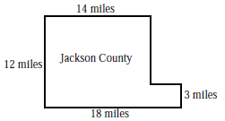
County Concerns
1. The Jackson County Executive Board is considering a proposal to conduct aerial spraying of insecticides to control the mosquito population. An agricultural organization supports the plan because mosquitoes cause crop damage. An environmental group opposes the plan because of possible food contamination and other medical risks.
Here are some facts about the case:
A map of Jackson County is shown here.
All county boundaries are on a S
north– south line or an east–west line.
The estimated annual cost of aerial
spraying is $29 per acre.
There are 640 acres in 1 square mile.
Plan supporters cite a study stating that for every $1 spent on insecticides, farmers would gain $4 through increased agricultural production.
a. What is the area of Jackson County in square miles? In acres?
b. What would be the annual cost to spray the whole county?
c. According to plan supporters, how much money would the farmers gain from the spraying program?

Slide 74
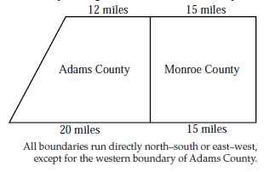
County Concerns
2. The sheriff of Adams County and the sheriff of Monroe County are having an argument. They each believe that their own county is larger than the other county.
Who is right? Write an explanation that would settle the argument.

Slide 75
Tasks Clarify Expectations
Range of content
Depth of knowledge
Type of reasoning and evidence of it
Types of applications

Slide 76
Assessments that Support Valid Inferences
Learning goal:
Understanding the definition of a triangle.
Performance task:
Draw a triangle.

Slide 77
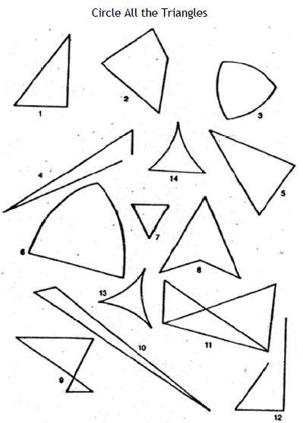

Slide 78
Analyzing Assessment Tasks
To what extent does the task:
Provide valid information about students’ knowledge?
Provide information about students’ conceptual understanding?
Provide information about students’ proficiency in mathematical processes: problem solving, reasoning and proof, communication, connections, and representation?

Slide 79
Understanding a Concept
Explain it to someone else
Represent it in multiple ways
Apply it to solve simple and complex problems
Reverse givens and unknowns
Compare and contrast it to other concepts
Use it as the foundation for learning other concepts

Slide 80
Common Assessment Planning Process
Plan
Develop
Administer and Analyze Students’ Performance
Critique
Revise

Slide 81
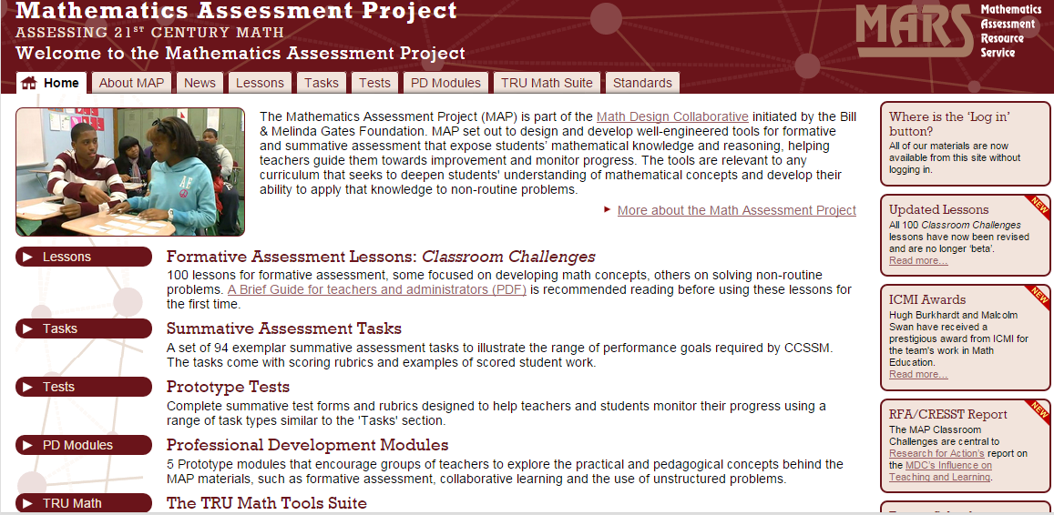
http://map.mathshell.org/

Slide 82
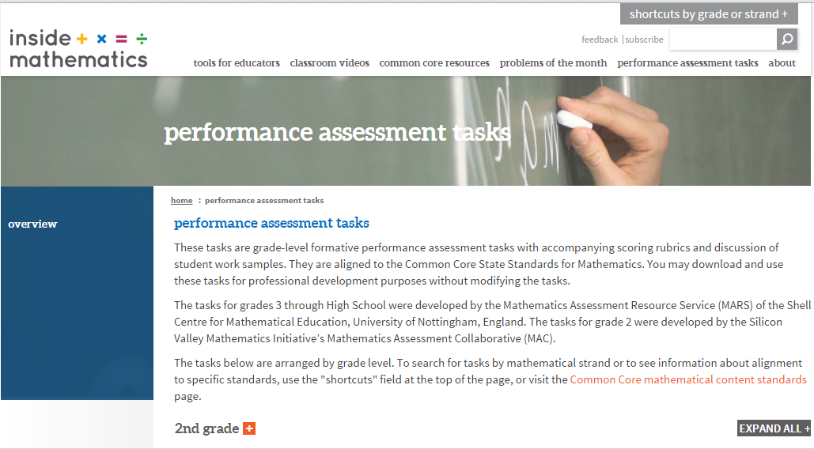
http://www.insidemathematics.org/performance-assessment-tasks

Slide 83
Access and Equity Principle
An excellent mathematics program requires that all students have access to a high-quality mathematics curriculum, effective teaching and learning, high expectations, and the support and resources needed to maximize their learning potential.

Slide 84
Access and Equity Principle
An excellent mathematics program requires that all students have access to a high-quality mathematics curriculum, effective teaching and learning, high expectations, and the support and resources needed to maximize their learning potential.

Slide 85
Students’ Mathematics Identities
Are how students see themselves and how they are seen by others, including teachers, parents, and peers, as doers of mathematics.
Aguirre, Mayfield-Ingram & Martin, 2013

Slide 86
Mathematics Identity
Mathematics identity includes:
  beliefs about one’s self as a mathematics learner;
  one’s perceptions of how others perceive him or her as a mathematics learner,
  beliefs about the nature of mathematics,
  engagement in mathematics, and
  perception of self as a potential participant in mathematics (Solomon, 2009).

Slide 87
Micromessages
Small, subtle unconscious messages we send and receive when we interact with others. Negative micromessages cause people to feel devalued, slighted, discouraged or excluded. Positive micromessages cause people to feel valued, included, or encouraged.
National Alliance for Partnerships in Equity, 2016

Slide 88
What Messages Are We Sending About Mathematical Identity?
“What don’t you understand? This is so simple.”
“It is immediately obvious that . . . . “
Which students participate in class?
How do they participate? What kind of questions are they asked? Wait time? Opportunities for elaboration/explanations?
Responses to students’ questions? To their answers?
Feedback: Effort-based vs intelligence-based praise.
Non-verbal communication—smiles, nods, etc.

Slide 89
Peer Observations to Uncover Micromessages and Unintentional Bias
Observe the classroom experiences of males/females and/or individuals of certain races or ethnicities
Number of interactions
Amount of wait/think time
Nature of questions—higher vs lower level
Nature of feedback
Amount of eye contact
Use of language

Slide 90
Collaboration is the Key to Improving Mathematics Teaching and Learning
High-Leverage Practices
Teaching for understanding, instead of how to get answers.
Collaborative lesson planning to implement effective teaching practices
Collaborative assessment planning
Collaborative peer observations to uncover micromessages.

Slide 91
Principles to Actions:
Ensuring Mathematical Success for All
Teaching and Learning
Access and Equity
Curriculum
Tools and Technology
Assessment
Professionalism
Essential Elements
of Effective Math
Programs

Slide 92
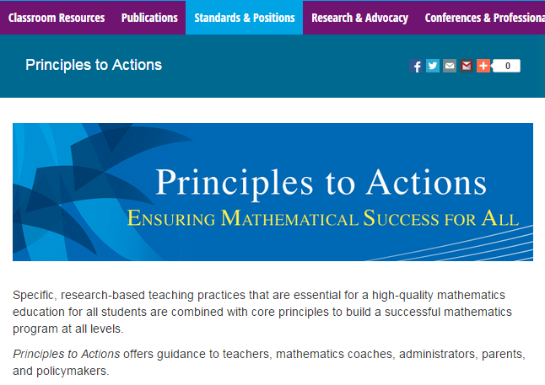
http://www.nctm.org/PtA/

Slide 93
Principles to Actions Resources
Principles to Actions Executive Summary
(in English and Spanish)
Principles to Actions overview presentation
Principles to Actions professional development guide (Reflection Guide)
Mathematics Teaching Practices presentations
  Elementary case, multiplication (Mr. Harris)
  Middle school case, proportional reasoning (Mr. Donnelly) (in English and Spanish)
  High school case, exponential functions (Ms. Culver)
Principles to Actions Spanish translation

Slide 94
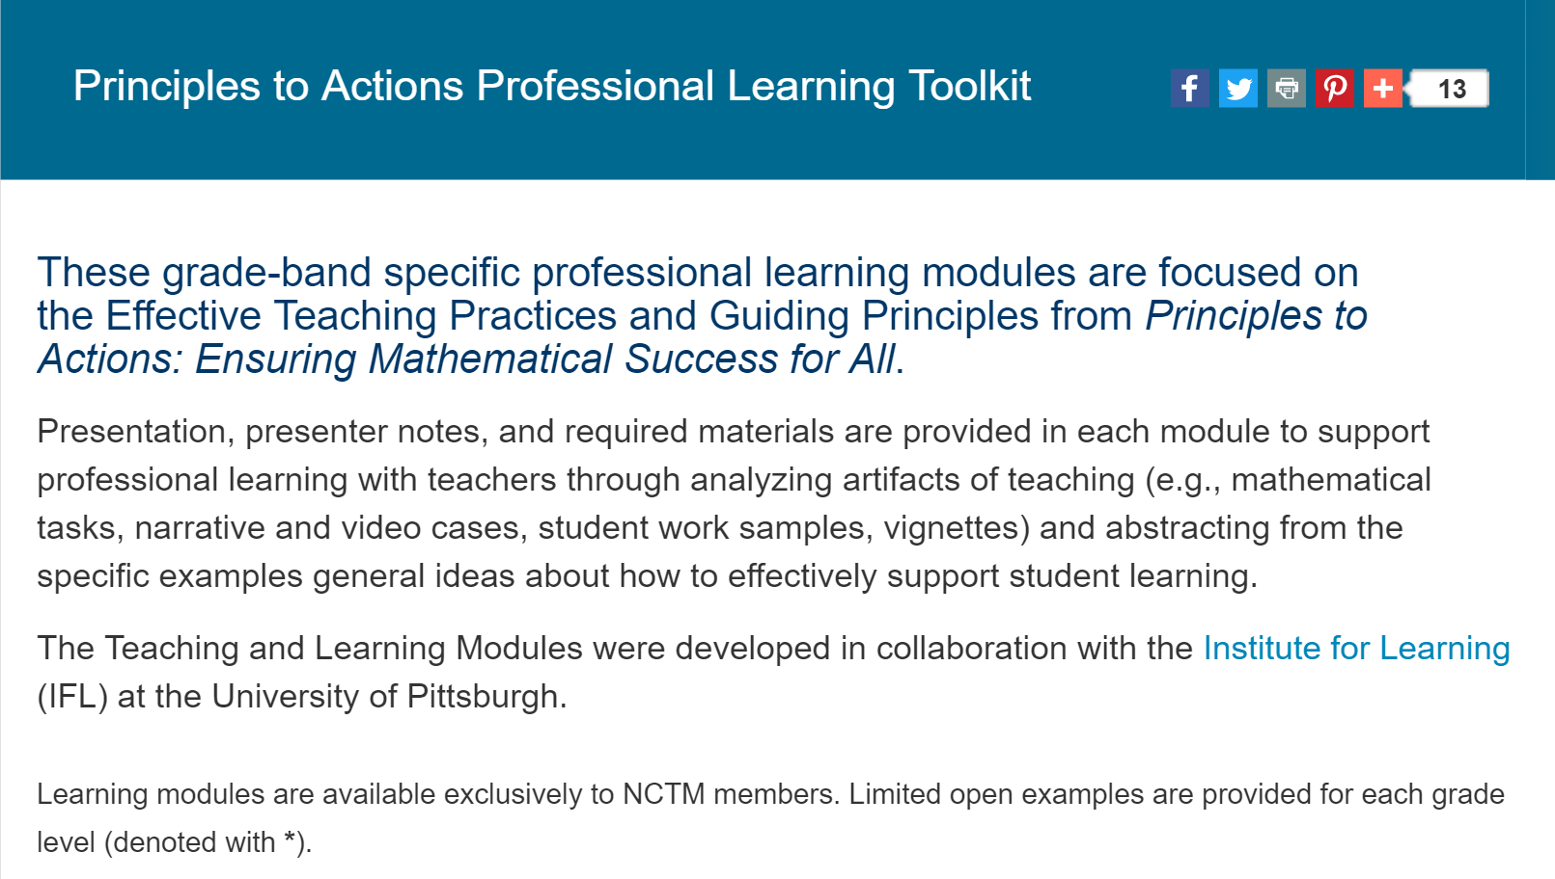
http://www.nctm.org/PtAToolkit/

Slide 95
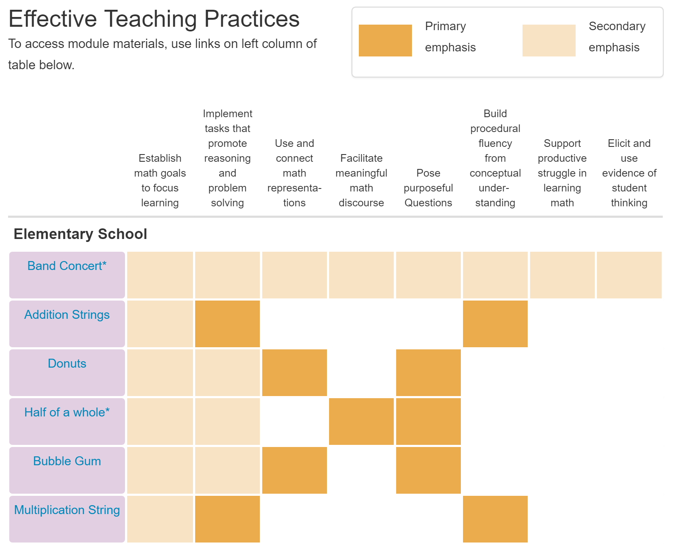
http://www.nctm.org/PtAToolkit/

Slide 96
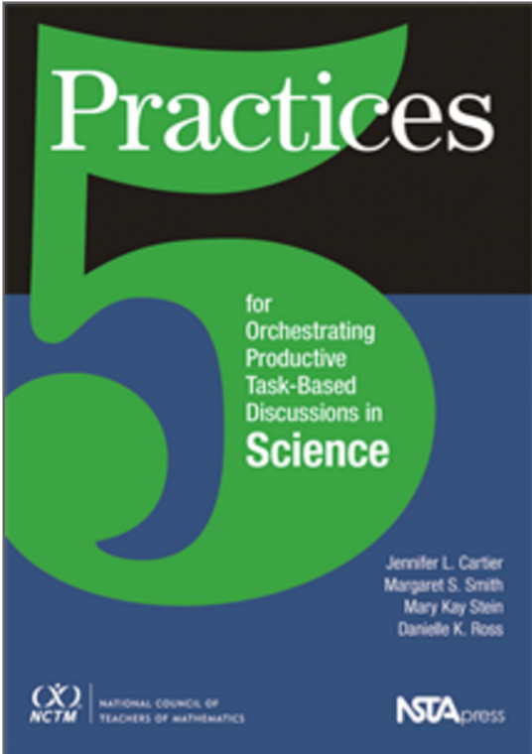
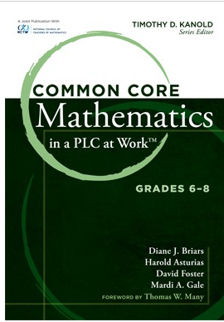
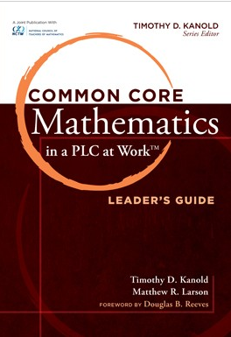
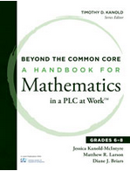
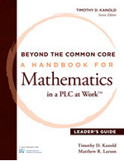
Collaborative Team Tools
Available at nctm.org

Slide 97
The Title Is Principles to Actions
What actions will you take to collaborate, communicate and connect to improve mathematics teaching and learning?

Slide 98
Thank You!
Diane Briars
dbriars@nctm.org
nctm.org/briars

